Slide 1
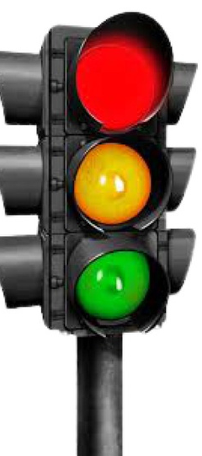
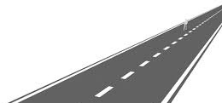
Automatic traffic signalling system

Slide 2
Traffic systems will change the signals according to the traffic, for instance, instead of round-robin schedules.
Problem statement
Application-like software can be uploaded with traffic images and outputs the timer according to the image data.

Slide 3
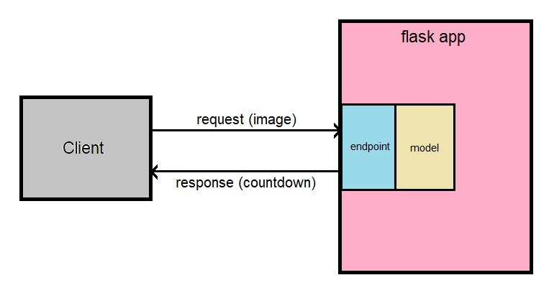
Implementation
We will provide the images to a Flask application.
The image processing is done at the backend.
The timer is sent as a response depending upon the
--> limit of vehicles
--> other information gathered from the image processing.

Slide 4



Technical side
It is an end-to-end open-source platform for machine learning.
It has a comprehensive, flexible ecosystem of tools, libraries, and community resources.
library of programming
functions Mainly aimed at real-time computer vision
It is an API of Python that allows us to build up web-applications.
It is used for the backend.

Slide 5



Technical side(Cont.)
It is an open-source software library that provides a Python interface for artificial neural networks.
Keras acts as an interface for the TensorFlow library.
The algorithm uses neural networks to provide real-time object detection.
Interpreted high-level general-purpose programming language.

Slide 6
Technical side(Cont.)
cvlib:
A simple, high level, easy-to-use open source Computer Vision library for Python
Matplotlib:
It is a comprehensive library for creating static, animated, and interactive visualizations in Python.

Slide 7
DEMO..!

Slide 8

Advantages
Reduces excessive traffic delays.
Reduces traffic congestion.
According to the traffic, it provides the required time for drivers in all directions.
Avoid being unnecessarily impatient and aggressive when driving.
It decreases rear-end vehicle collisions.
The pollution rate can be decremented.

Slide 9

Future works
Since the accuracy of the system is subjected to vehicle count, we could integrate a training mechanism so that the system can learn from experience.
The timer can be automatically adjusted according to the type of vehicle. Hence, training can be given to implementing this functionality.
Data about vehicle traffic and effectiveness can be stored in a database which can be used for modeling the system updates and can be used by officials to know the traffic patterns in large cities.

Slide 10
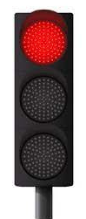

Thank you!
Do you have any questions for us?

